Slide 1
Internet of Things MODULE-1 (Introduction to the Internet of Things )
By
Dr. N. Ramana
Associate Professor
Kakatiya University

Slide 2
COURSE OUTCOMES
Interpret the impact and challenges posed by IoT networks leading to new architectural models.
Compare and contrast the deployment of smart objects and the technologies to connect them to network.
Appraise the role of IoT protocols for efficient network communication.
Identify the applications of IoT in Industry.

Slide 3
MODULE-1
History of Iot
Iot Definition ,How IoT works?
Why Is Internet of Things (IoT) so important?
Examples of IoT in Daily Life
Environmental Impact of IoT ,Real-World Applications of IoT
Industrial IoT (IIoT), IIoT in manufacturing ,Careers in IoT
Getting involved in IoT, IoT and Privacy
The role of regulations in IoT, Top IoT technologies and trends ,IoT challenges , Future of IoT
Conclusion.

Slide 4
HISTORY of IOT
1999- The term "Internet of Things" was used by Kevin Ashton during his work at P&G which became widely accepted
2004 - The term was mentioned in famous publications like the Guardian, Boston Globe, and Scientific American
2005- UN's International Telecommunications Union (ITU) published its first report on this topic.
2008- The Internet of Things was born
2011- Gartner, the market research company, include "The Internet of Things" technology in their research

Slide 5
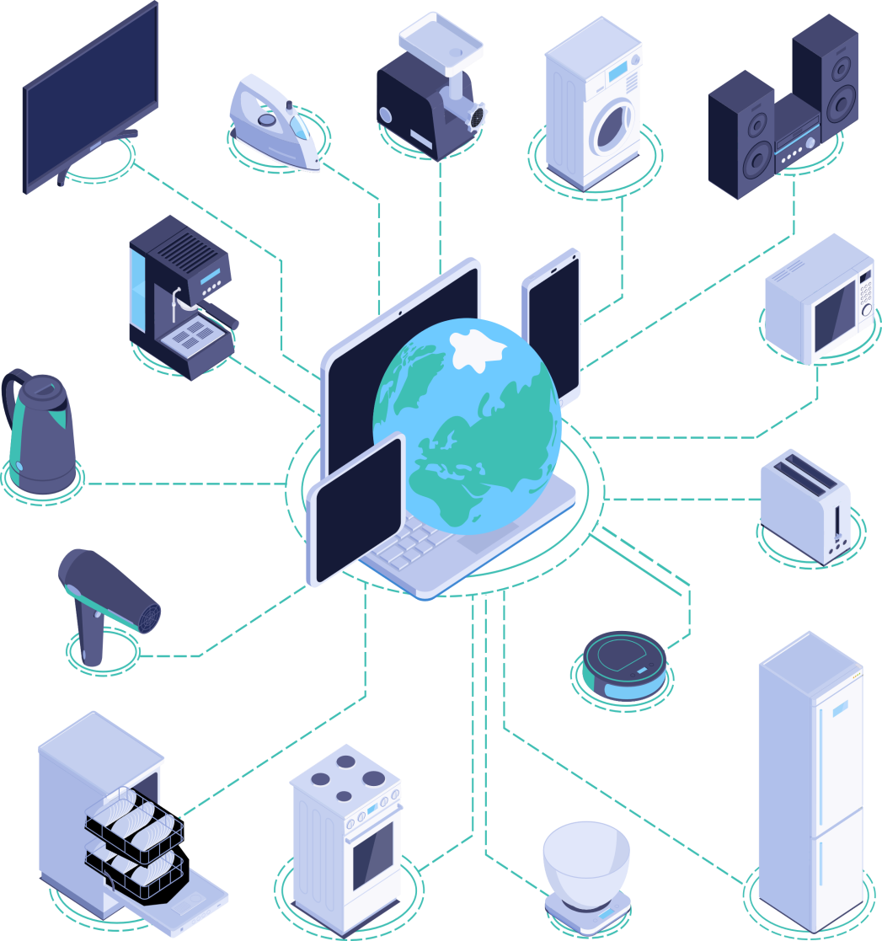
What is the Internet of Things?
Definition: The Internet of Things refers to a network of physical objects or "things" embedded with sensors, software, and other technologies that enable them to connect and exchange data with other devices and systems over the internet
Example: Think of IoT as a giant web connecting devices such as smartphones, smart home appliances like thermostats and lights, wearable fitness trackers, and even industrial machinery

Slide 6


How Does IoT Work?
Sensors
IoT devices are equipped with sensors and that can detect changes or events in their environment, such as temperature, motion, light, or sound
Connectivity
These devices are connected to the internet, allowing them to transmit data to other devices or systems over wi-fi, cellular networks, or other communication protocols
Sensors
Connectivity

Slide 7
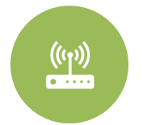
How Does IoT Work?
Actions
Based on the data collected from sensors, IoT devices can perform various actions, such as adjusting settings, triggering alerts, or initiating automated processes, either locally or remotely through a central control system or smartphone app

Slide 8
Why is IoT Important?
Convenience
IoT devices make our lives easier by automating tasks and providing remote access to control various aspects of our environment, such as adjusting the temperature in our homes or tracking our fitness goals
Efficiency
By collecting and analyzing data, IoT devices can optimize processes, reduce energy consumption, and minimize waste, leading to greater efficiency in industries like manufacturing, agriculture, and transportation
Safety
IoT enhances safety by monitoring environments in real-time and providing alerts or notifications in case of emergencies, such as detecting smoke in a smart home's fire alarm system or monitoring air quality in a smart city

Slide 9
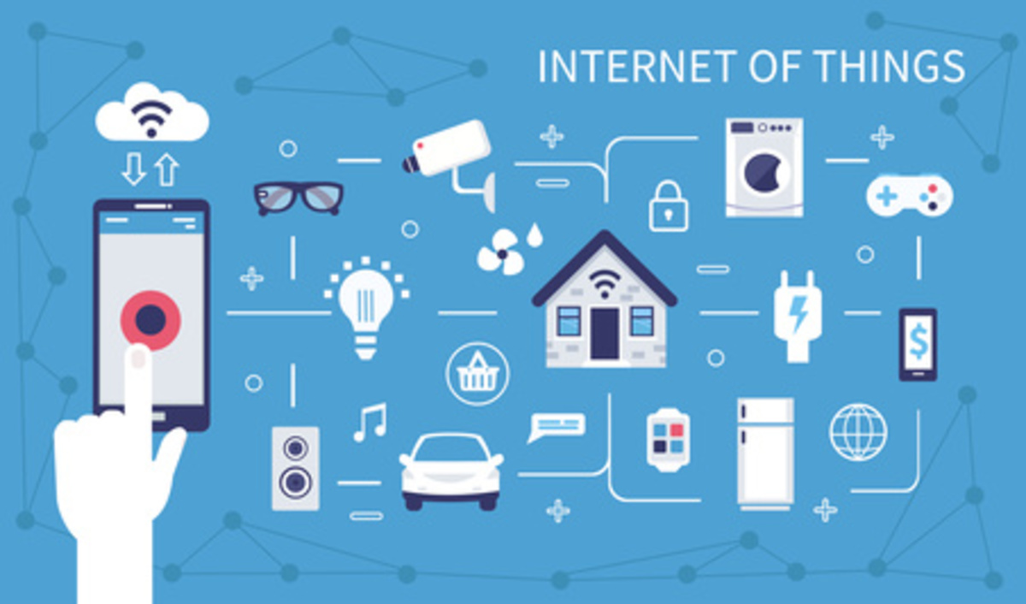
Examples of IoT in Daily Life
Smart Home:
Control lights, thermostats, and security cameras remotely
Transportation:
Connected cars with navigation and safety features
Wearables:
Track fitness, monitor health, and receive notifications

Slide 10

IoT in Healthcare
Remote Monitoring:
Devices track vital signs and health metrics
Telemedicine:
Allows patients to consult with healthcare professionals remotely
Medication Management:
Reminder systems help patients adhere to medication schedules

Slide 11
IoT in Agriculture
Precision Farming: Sensors monitor soil conditions and crop health
Livestock Monitoring: Track animal behavior and health remotely
Automated Irrigation: Optimize water usage for crops

Slide 12


In IoT-based smart farming, a system is built for monitoring the crop field with the help of sensors (light,humidity,temperature, soil moisture, etc.) and automating the irrigation system. The farmers can monitor the field conditions from anywhere. This is highly efficient compared to the traditional or conventional approach.
Smart farming: Use of IoT to improve agriculture
In IoT-based smart farming, a system is built for monitoring the crop field with the help of sensors (light, humidity, temperature, soil moisture, etc.) and automating the irrigation system. The farmers can monitor the field conditions from anywhere. This is highly efficient compared to the traditional or conventional approach.
In terms of environmental issues, IoT-based smart farming provides great benefits including better and efficient water usage, and optimization of inputs and treatments.

Slide 13


Smart farming: Use of IoT to improve agriculture
Therefore, smart farming based on IoT technologies enables growers and farmers to reduce waste and enhance productivity
Some of the IoT applications in this area are:
Precision farming
Agricultural drones
Livestock monitoring
Smart greenhouses

Slide 14
IoT in Education
Smart Classrooms: Interactive whiteboards and personalized learning
Remote Learning: Access educational resources from anywhere
Safety Systems: IoT devices such as security cameras, door sensors, and emergency alert systems can enhance school safety by monitoring school premises, detecting potential threats, and alerting authorities in case of emergencies like intruders or natural disasters

Slide 15
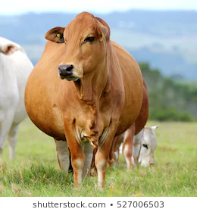
IoT-based Smart Farming
Utilize wireless IoT applications to collect data regarding the location, well-being, and health of their livestock
Monitor pregnant cows:
Sensor powered by battery is expelled when its water breaks.
This sends an information via the Internet to the rancher.

Slide 16
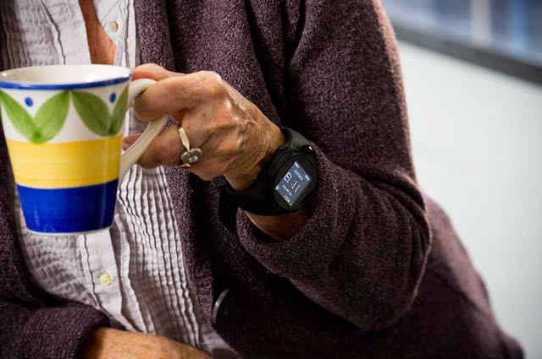
IoT for the Elderly
With a built-in accelerometer that automatically detects falls
Medication reminder
With a GPS, which allows an emergency operator to locate and provide directions to the individual.

Slide 17
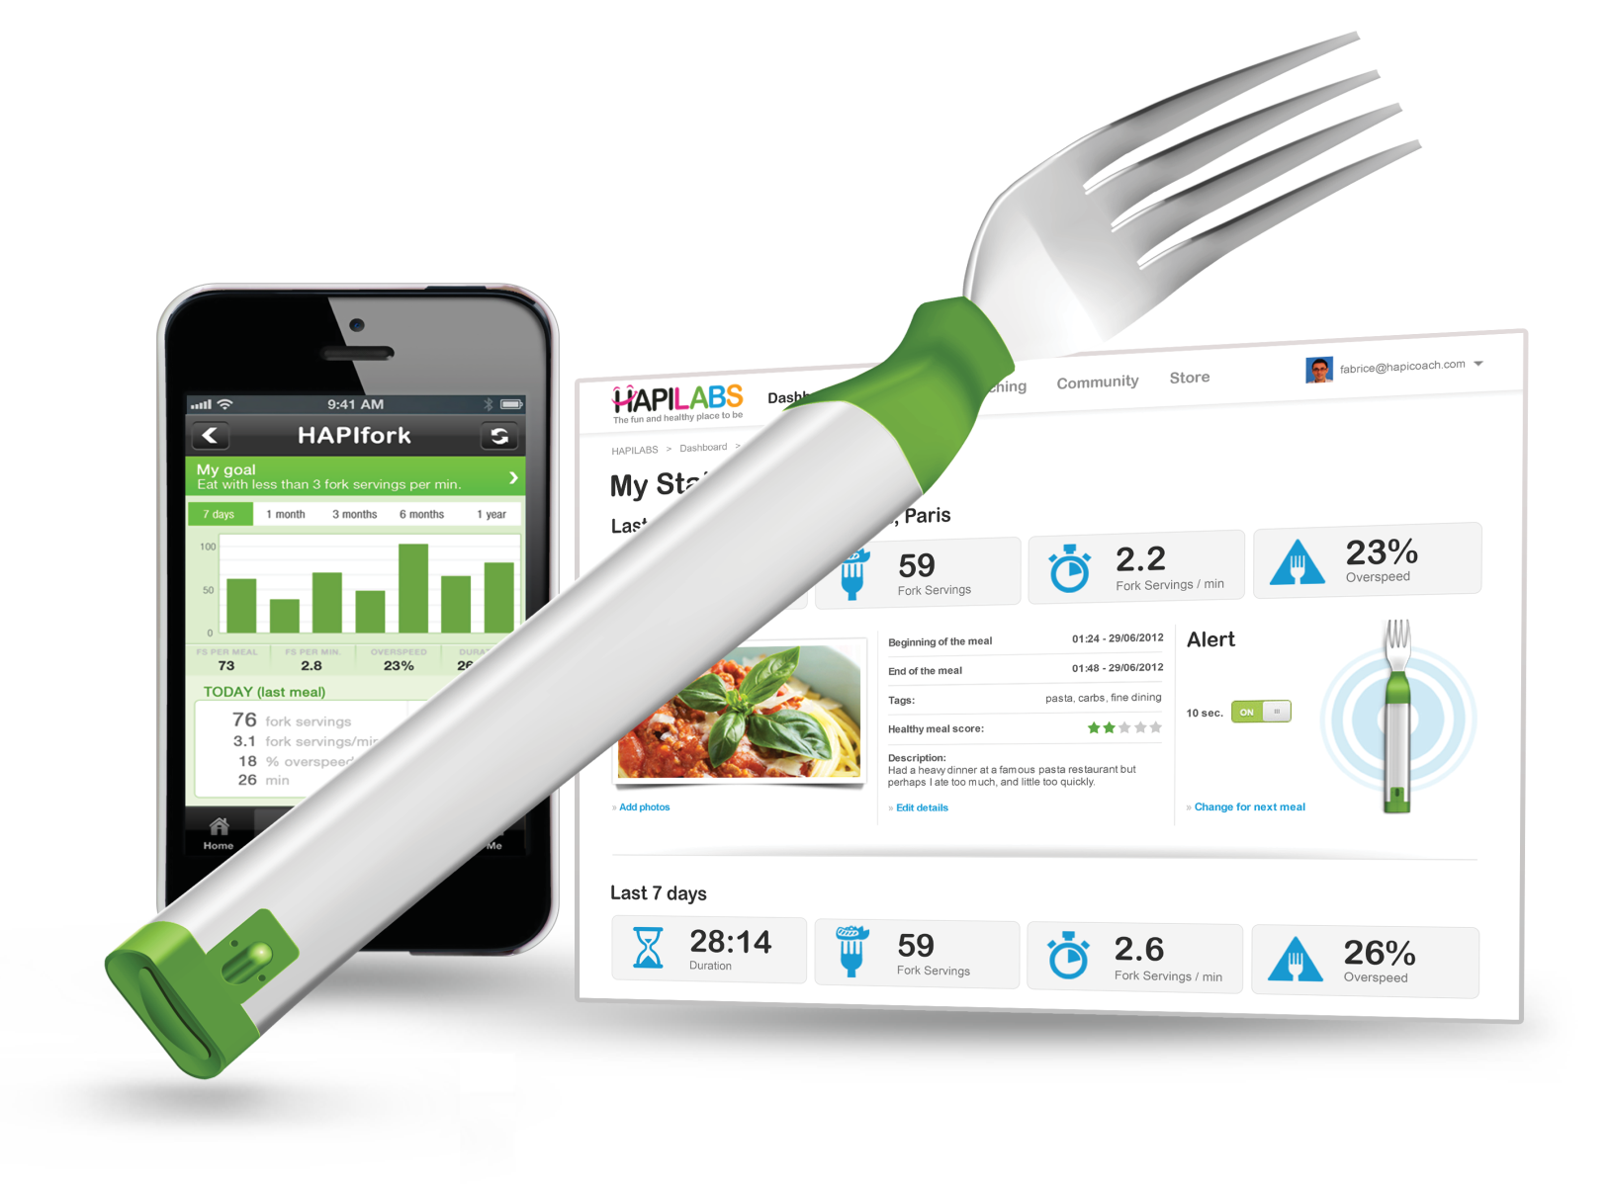
IoT for the Elderly
The HAPIfork is an electronic fork that helps you monitor and track your eating habits.
It also alerts you with the help of indicator lights and gentle vibrations when you are eating too fast.

Slide 18
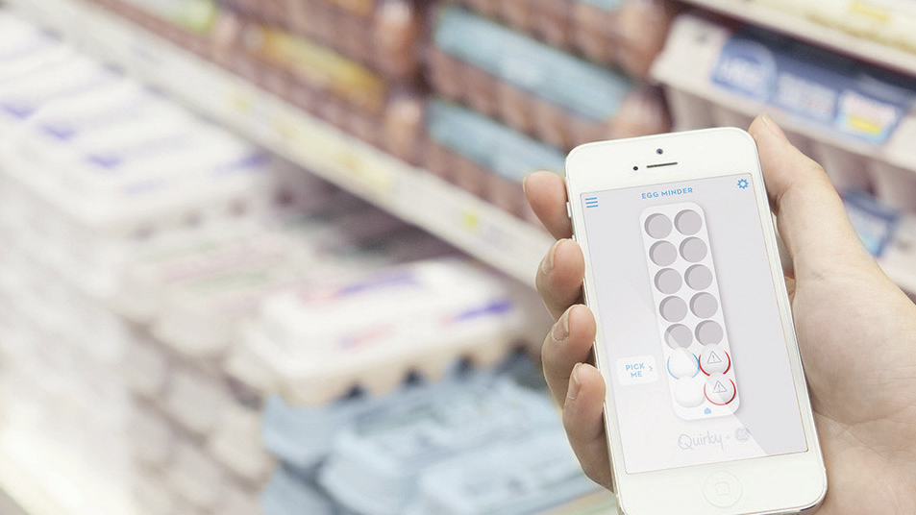
Smart Egg Tray
The Egg Minder syncs with your smartphone to tell you how many eggs you’ve got at home (up to 14 eggs) and when they’re going bad.

Slide 19
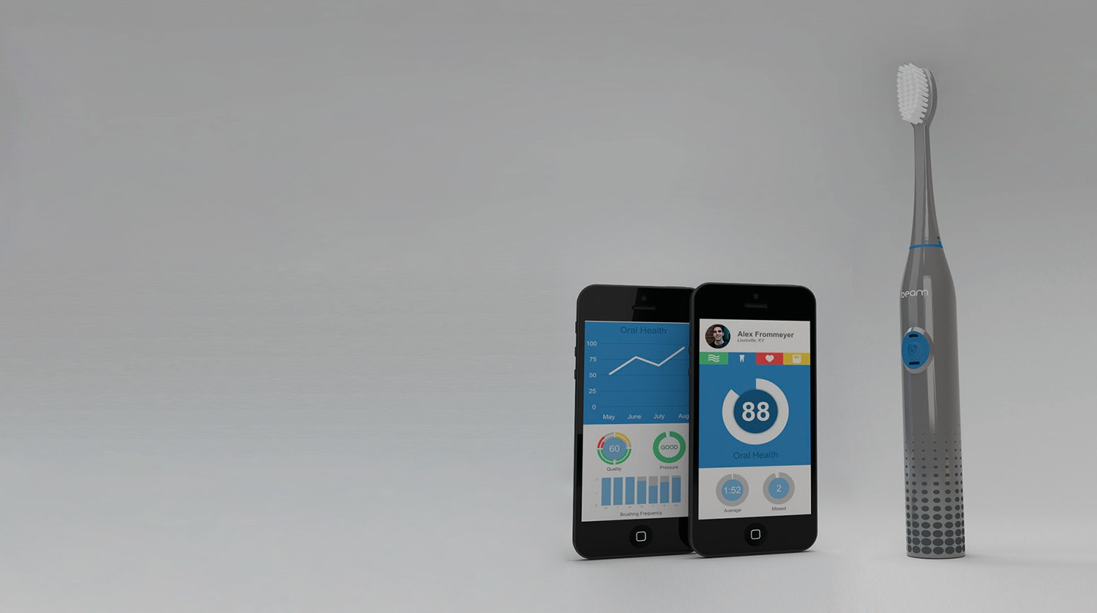
Smart Tooth Brush
The Beam Brush is a connected toothbrush that engages users with their daily hygiene routine.

Slide 20
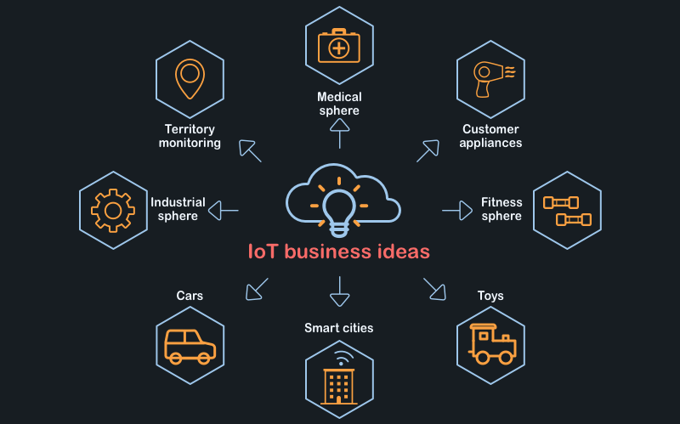
IoT business opportunities

Slide 21
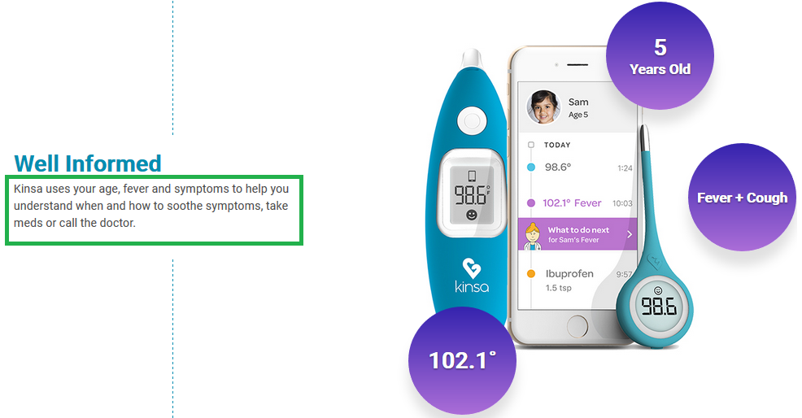
Kinsa thermometer
Monitoring your temperature and can call your doctor as necessary

Slide 22
Environmental Impact of IoT
Energy Efficiency: Smart devices optimize energy usage
Resource Conservation: Sensors help in conserving water and reducing waste
Sustainable Practices: IoT enables more sustainable practices in industries like agriculture and transportation

Slide 23
Real-World Applications of IoT
Smart Cities: Traffic management, waste management, and energy conservation
Industrial IoT: Predictive maintenance, supply chain optimization, and quality control
Environmental Monitoring: Air quality monitoring, weather forecasting, and disaster management

Slide 24
Industrial IoT (IIoT)
Industrial IoT (IIoT) focusses on the use of cyber-physical systems to monitor the physical factory processes and make data-based automated decisions.
While the physical systems are made the intelligent using IoT, the real-time communication, and cooperation both with each other and with humans is established via the wireless web
IIoT brings in the concept of ‘a connected factory leads to a smart factory’.

Slide 25
IIoT in manufacturing
Digital/connected factory: IoT enabled machinery can transmit operational information to the partners like original equipment manufacturers and to field engineers.
Facility management: The use of IoT sensors in manufacturing equipment enables condition-based maintenance alerts.
Production flow monitoring: IoT in manufacturing can enable the monitoring of production lines starting from the refining process down to the packaging of final products.
Inventory management: IoT applications permit the monitoring of events across a supply chain.

Slide 26
IIoT in manufacturing
Plant Safety and Security: IoT combined big data analysis can improve the overall workers’ safety and security in the plant. .
Quality control: IoT sensors collect aggregate product data and other third-party syndicated data from various stages of a product cycle.
Packaging Optimization: By using IoT sensors in products and/or packaging, manufacturers can gain insights into the usage patterns and handling of product from multiple customers.
Logistics and Supply Chain Optimization: The Industrial IoT (IIoT) can provide access to real-time supply chain information by tracking materials, equipment, and products as they move through the supply chain.

Slide 27
Careers in IoT
Data Scientist: Analyzes data collected by IoT devices
Software Engineer: Develops applications and platforms for IoT
Cybersecurity Specialist: Protects IoT systems from cyber threats

Slide 28
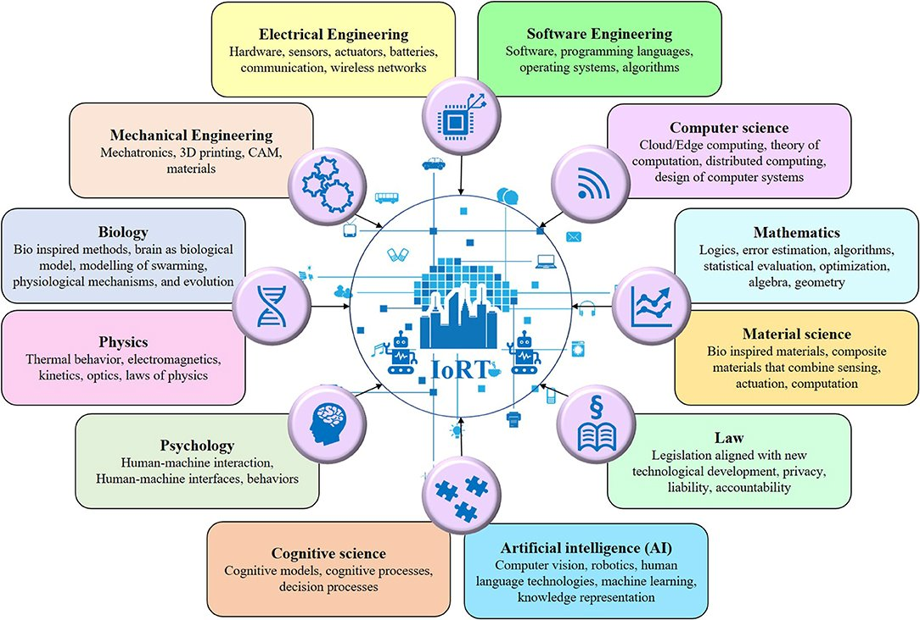

Slide 29
Getting Involved in IoT
Learn Coding: Develop programming skills to create IoT applications
Experiment: Build simple IoT projects using microcontrollers like Arduino or Raspberry Pi
Explore: Research and learn about different IoT technologies and applications

Slide 30
IoT and Privacy
Data Collection: Understand what data is being collected by IoT devices
Consent: Ensure that users are aware of and consent to data collection
Security Measures: Implement security measures to protect personal information

Slide 31
The Role of Regulation in IoT
Privacy Regulations: Laws governing the collection and use of personal data
Security Standards: Guidelines for ensuring the security of IoT devices and networks
Industry Standards: Standards to ensure interoperability and compatibility among IoT devices

Slide 32
Top 10 Strategic IoT Technologies and Trends
Trend No. 1: Artificial Intelligence (AI): “Data is the fuel that powers the IoT and the organization’s ability to derive meaning from it will define their long term success.”
Trend No. 2: Social, Legal and Ethical IoT: These include ownership of data and the deductions made from it, algorithmic bias, privacy and compliance with regulations such as the General Data Protection Regulation. “Successful deployment of an IoT solution demands that it’s not just technically effective but also socially acceptable.”
Trend No. 3: Infonomics and Data Broking: The theory of infonomics takes monetization of data further by seeing it as a strategic business asset to be recorded in the company accounts. By 2023, the buying and selling of IoT data will become an essential part of many IoT systems.

Slide 33
Top 10 Strategic IoT Technologies and Trends
4. Trend No. 4: The Shift from Intelligent Edge to Intelligent Mesh: The shift from centralized and cloud to edge architectures is well under way in the IoT space. These mesh architectures will enable more flexible, intelligent and responsive IoT systems — although often at the cost of additional complexities.
5. Trend No. 5: IoT Governance: As the IoT continues to expand, the need for a governance framework that ensures appropriate behaviour in the creation, storage, use and deletion of information related to IoT projects will become increasingly important.
6. Trend No. 6: Sensor Innovation: The sensor market will evolve continuously through 2023. New sensors will enable a wider range of situations and events to be detected.

Slide 34
Top 10 Strategic IoT Technologies and Trends
Trend No. 7: Trusted Hardware and Operating System: ‘.. by 2023, we expect to see the deployment of hardware and software combinations that together create more trustworthy and secure IoT systems…’.
Trend 8: Novel IoT User Experiences: User experience driven by 4 factors: new sensors, new algorithms, new experience architectures and context, and socially aware experiences.
Trend No. 9: Silicon Chip Innovation: By 2023, it’s expected that new special-purpose chips will reduce the power consumption required to run IoT devices.
Trend No. 10: New Wireless Networking Technologies for IoT: IoT networking involves balancing a set of competing requirements. In particular they should explore 5G, the forthcoming generation of low earth orbit satellites, and backscatter networks.

Slide 35
Challenges of IoT
Security: Protecting data and preventing unauthorized access
Privacy: Ensuring personal information is kept confidential
Compatibility: Ensuring devices can communicate with each other seamlessly

Slide 36
Future of IoT
Growth: The number of IoT devices is expected to grow exponentially in the coming years
Innovation: IoT will continue to drive innovation in various fields such as healthcare, agriculture, and transportation
Challenges: As IoT expands, addressing security and privacy concerns will become increasingly important

Slide 37
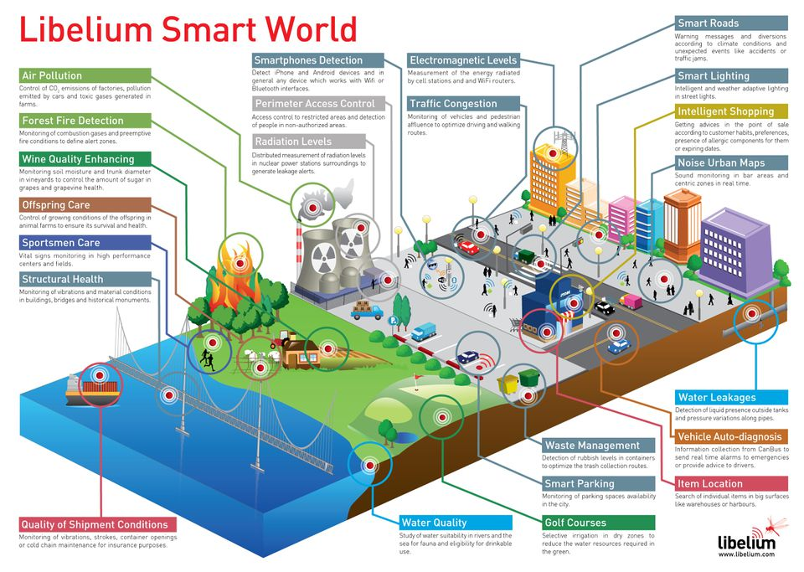
The smart world of the future – using Iot

Slide 38
Conclusion
Recap: The Internet of Things connects devices and enables them to communicate and share data
Impact: IoT enhances convenience, efficiency, and safety in our daily lives
Future: With continued growth and innovation, IoT will play an even bigger role in shaping the world around us

Slide 39
Questions
1) define IoT
2) why is IoT important
3) what are IoT applications
4) What are the different components of IoT?
5) Explain the characteristics of IoT.
6) Explain the term ‘smart city’ in IoT
7) What are the challenges or risks associated with IoT?
8) Write some different types of sensors in IoT?
9) Why Internet of Things(IoT) will be successful in the coming years?
10) what are technologies in IoT?

Slide 40
Questions
1) define IoT
2) why is IoT important
3) what are IoT applications
4) What are the different components of IoT?
5) Explain the characteristics of IoT.
6) Explain the term ‘smart city’ in IoT
7) What are the challenges or risks associated with IoT?
8) Write some different types of sensors in IoT?
9) Why Internet of Things(IoT) will be successful in the coming years?
10) what are technologies in IoT?

